Slide 1
Engineering Management
Organizing
Lecture 16,17,18

Slide 2
Objectives
Analyze the different forms of an organization.
Explain different organizational structures.
Describe the differences in line and staff relationships.
Describe the use and value of teams.

Slide 3
Organizing
Teams are important part of the workforce today, and they are created either within the planning function or the organizing function, or with other management functions discussed in later chapters. Often, there are impromptu teams that are formed by employees spontaneously. Today many teams are virtual, or e-teams, and they work across space, time, and organizational boundaries with links strengthened by webs of communication technologies.

Slide 4
Nature of organizing
The sole proprietorship is a business owned and operated by one person. It is simple to organize and to shut down, has few legal restrictions, and the owner is free to make all decisions. Profit from it is taxed only once—on the Schedule C (Profit or Loss from Business or Profession) attachment to the owner’s individual income tax form.

Slide 5
Nature of organizing
The Partnership is an “association of two or more partners to carry on as co-owners of a business for profit” (Uniform Partnership Act). The partnership is almost as easy to organize as a proprietorship and has relatively few legal restrictions. Partnerships permit pooling the managerial skills and judgments and the financial strengths of several people who have a direct financial interest in the enterprise, but suffer the disadvantages of divided decision-making authority and potential Damage to the business when partners disagree.

Slide 6
Nature of organizing
A limited liability company (LLC) is a relatively new business structure allowed by state statute. Owners, called members, have limited personal liability for the debts and actions of the LLC. There is no maximum number of members and most states permit single member LLCs.
Notes:
LLCs do not pay taxes on their profits directly. Their profits and losses are passed through to members, who report them on their individual tax returns

Slide 7
Nature of organizing
Corporations are legal entities owned by shareholders, who in general have no liability beyond loss of the value of their stock. Corporations have perpetual life (as long as they submit an annual report to the state in which they are chartered), and they find it easier to raise money, transfer ownership, and change management. It is more difficult and expensive to organize a corporation.

Slide 8
Organizing by Key activities
Effective organizing must first consider the basic mission and long-range objectives established for the organization. Peter Drucker recommends first identifying the key activities, which he terms the “load-bearing parts of the structure.” He poses three questions to help identify the key activities:
In what area is excellence required to obtain the company’s objectives?
In what areas would lack of performance endanger the results, if not the survival, of the enterprise?
What are the values that are truly important to us in this company?

Slide 9
Traditional organization theory
Patterns of Departmentation
Organizations are divided into smaller units by using a number of different approaches. A hierarchical organization is an organizational structure where every entity in the organization, except one, is subordinate to a single other entity. This arrangement is a form of a hierarchy. This is the Dominant mode of organization among large organizations; most corporations, governments, and Organized religions are hierarchical organizations.

Slide 10
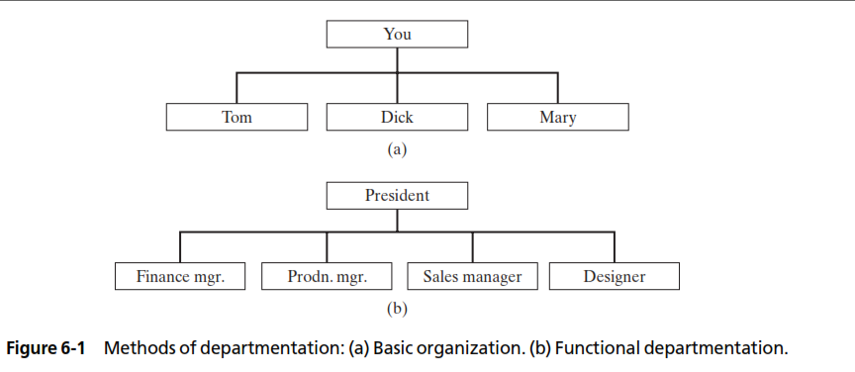
Traditional organization theory

Slide 11
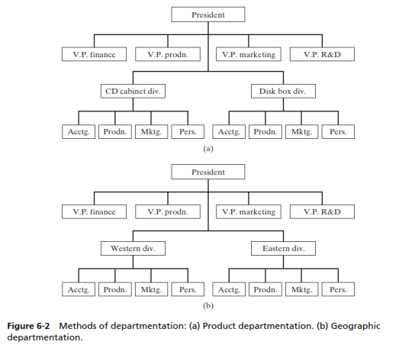
Traditional organization theory

Slide 12
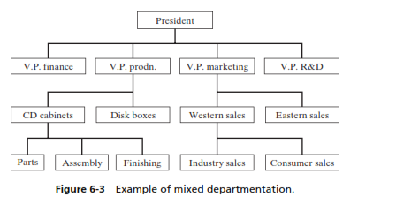
Traditional organization theory

Slide 13
Span of control
As soon as a new organization grows to a significant size, subordinate managers must be appointed to help the top manager manage. This need was recognized as soon as large groups of people began working toward a common purpose.

Slide 14
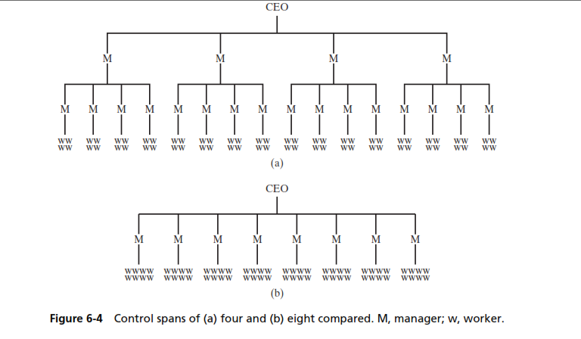
Span of control

Slide 15
Teams
A team is defined as follows: a small number of people who are committed to a common goal, objectives, and approach to this goal that they are mutually accountable to reaching.
Teams quite often have complementary skills that are used in the problem solving. Workers today must be able to work together in interdisciplinary teams to carry out and coordinate the operations of the enterprise
• Establish urgency and direction. All team members need to believe the team has clear objectives.
Select members based on skill and skill potential, not personalities.
Pay particular attention of first meetings and actions.

Slide 16
Teams
Set some clear rules of behavior.
Set and seize upon a few immediate performance oriented tasks and goals.
Challenge the group regularly with fresh facts and information.
Spend time together.
Use positive feedback,recognition,and reward.

